Slide 1
Ghosts on LSST ComCam
Where we are currently ? #2

Slide 2
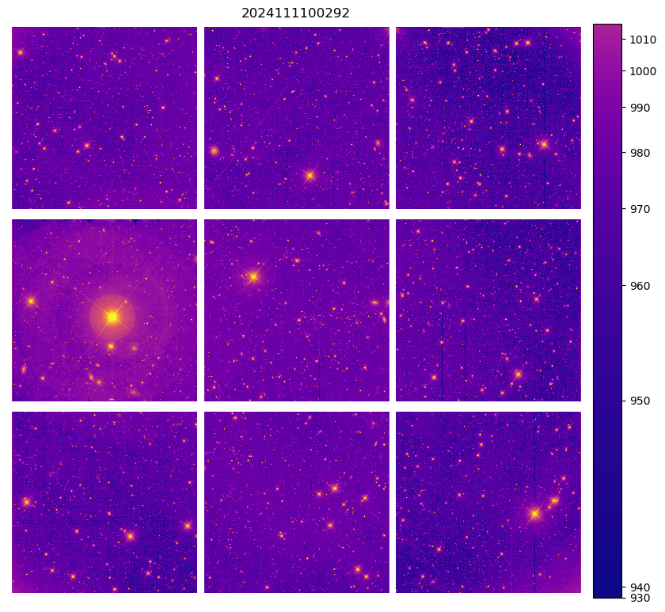
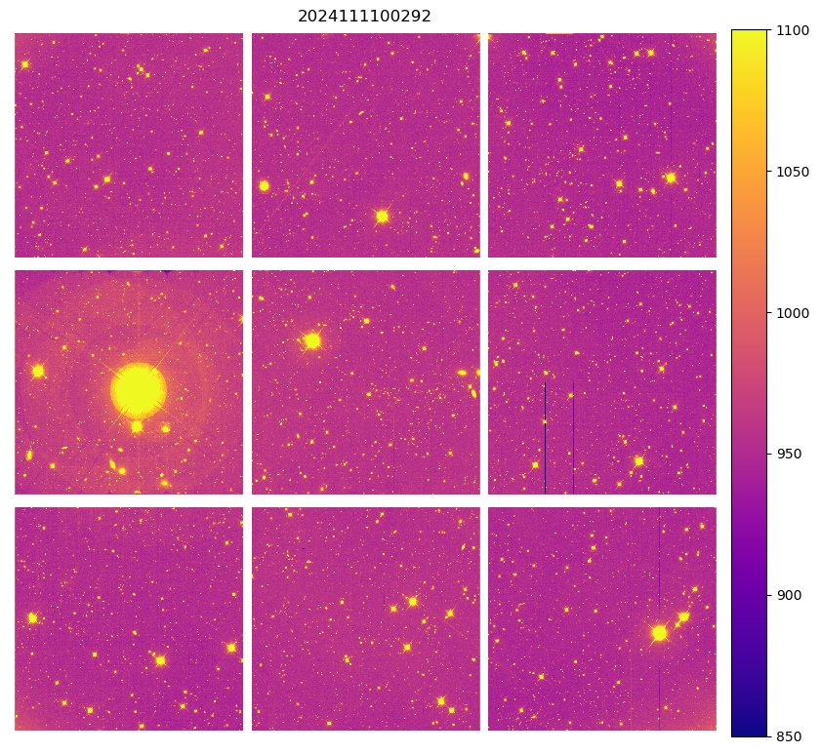
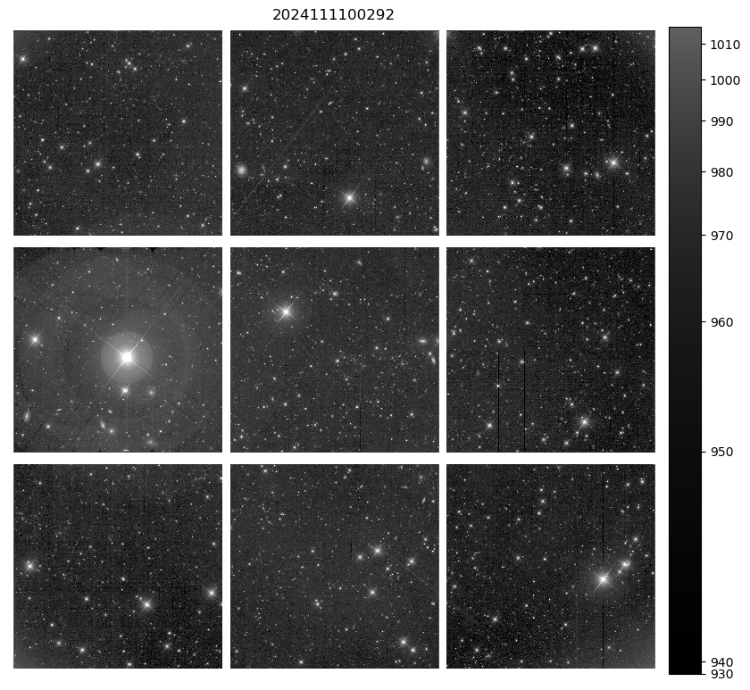
Data used

Slide 3
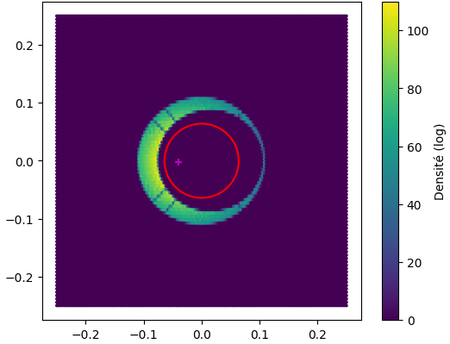
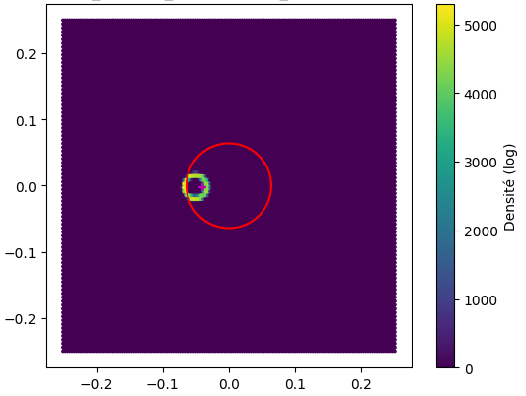
Batoid package (1)
Use ComCam’s config
Choice of the filter
Integreted spyders
github.com/jmeyers314/batoid

Slide 4
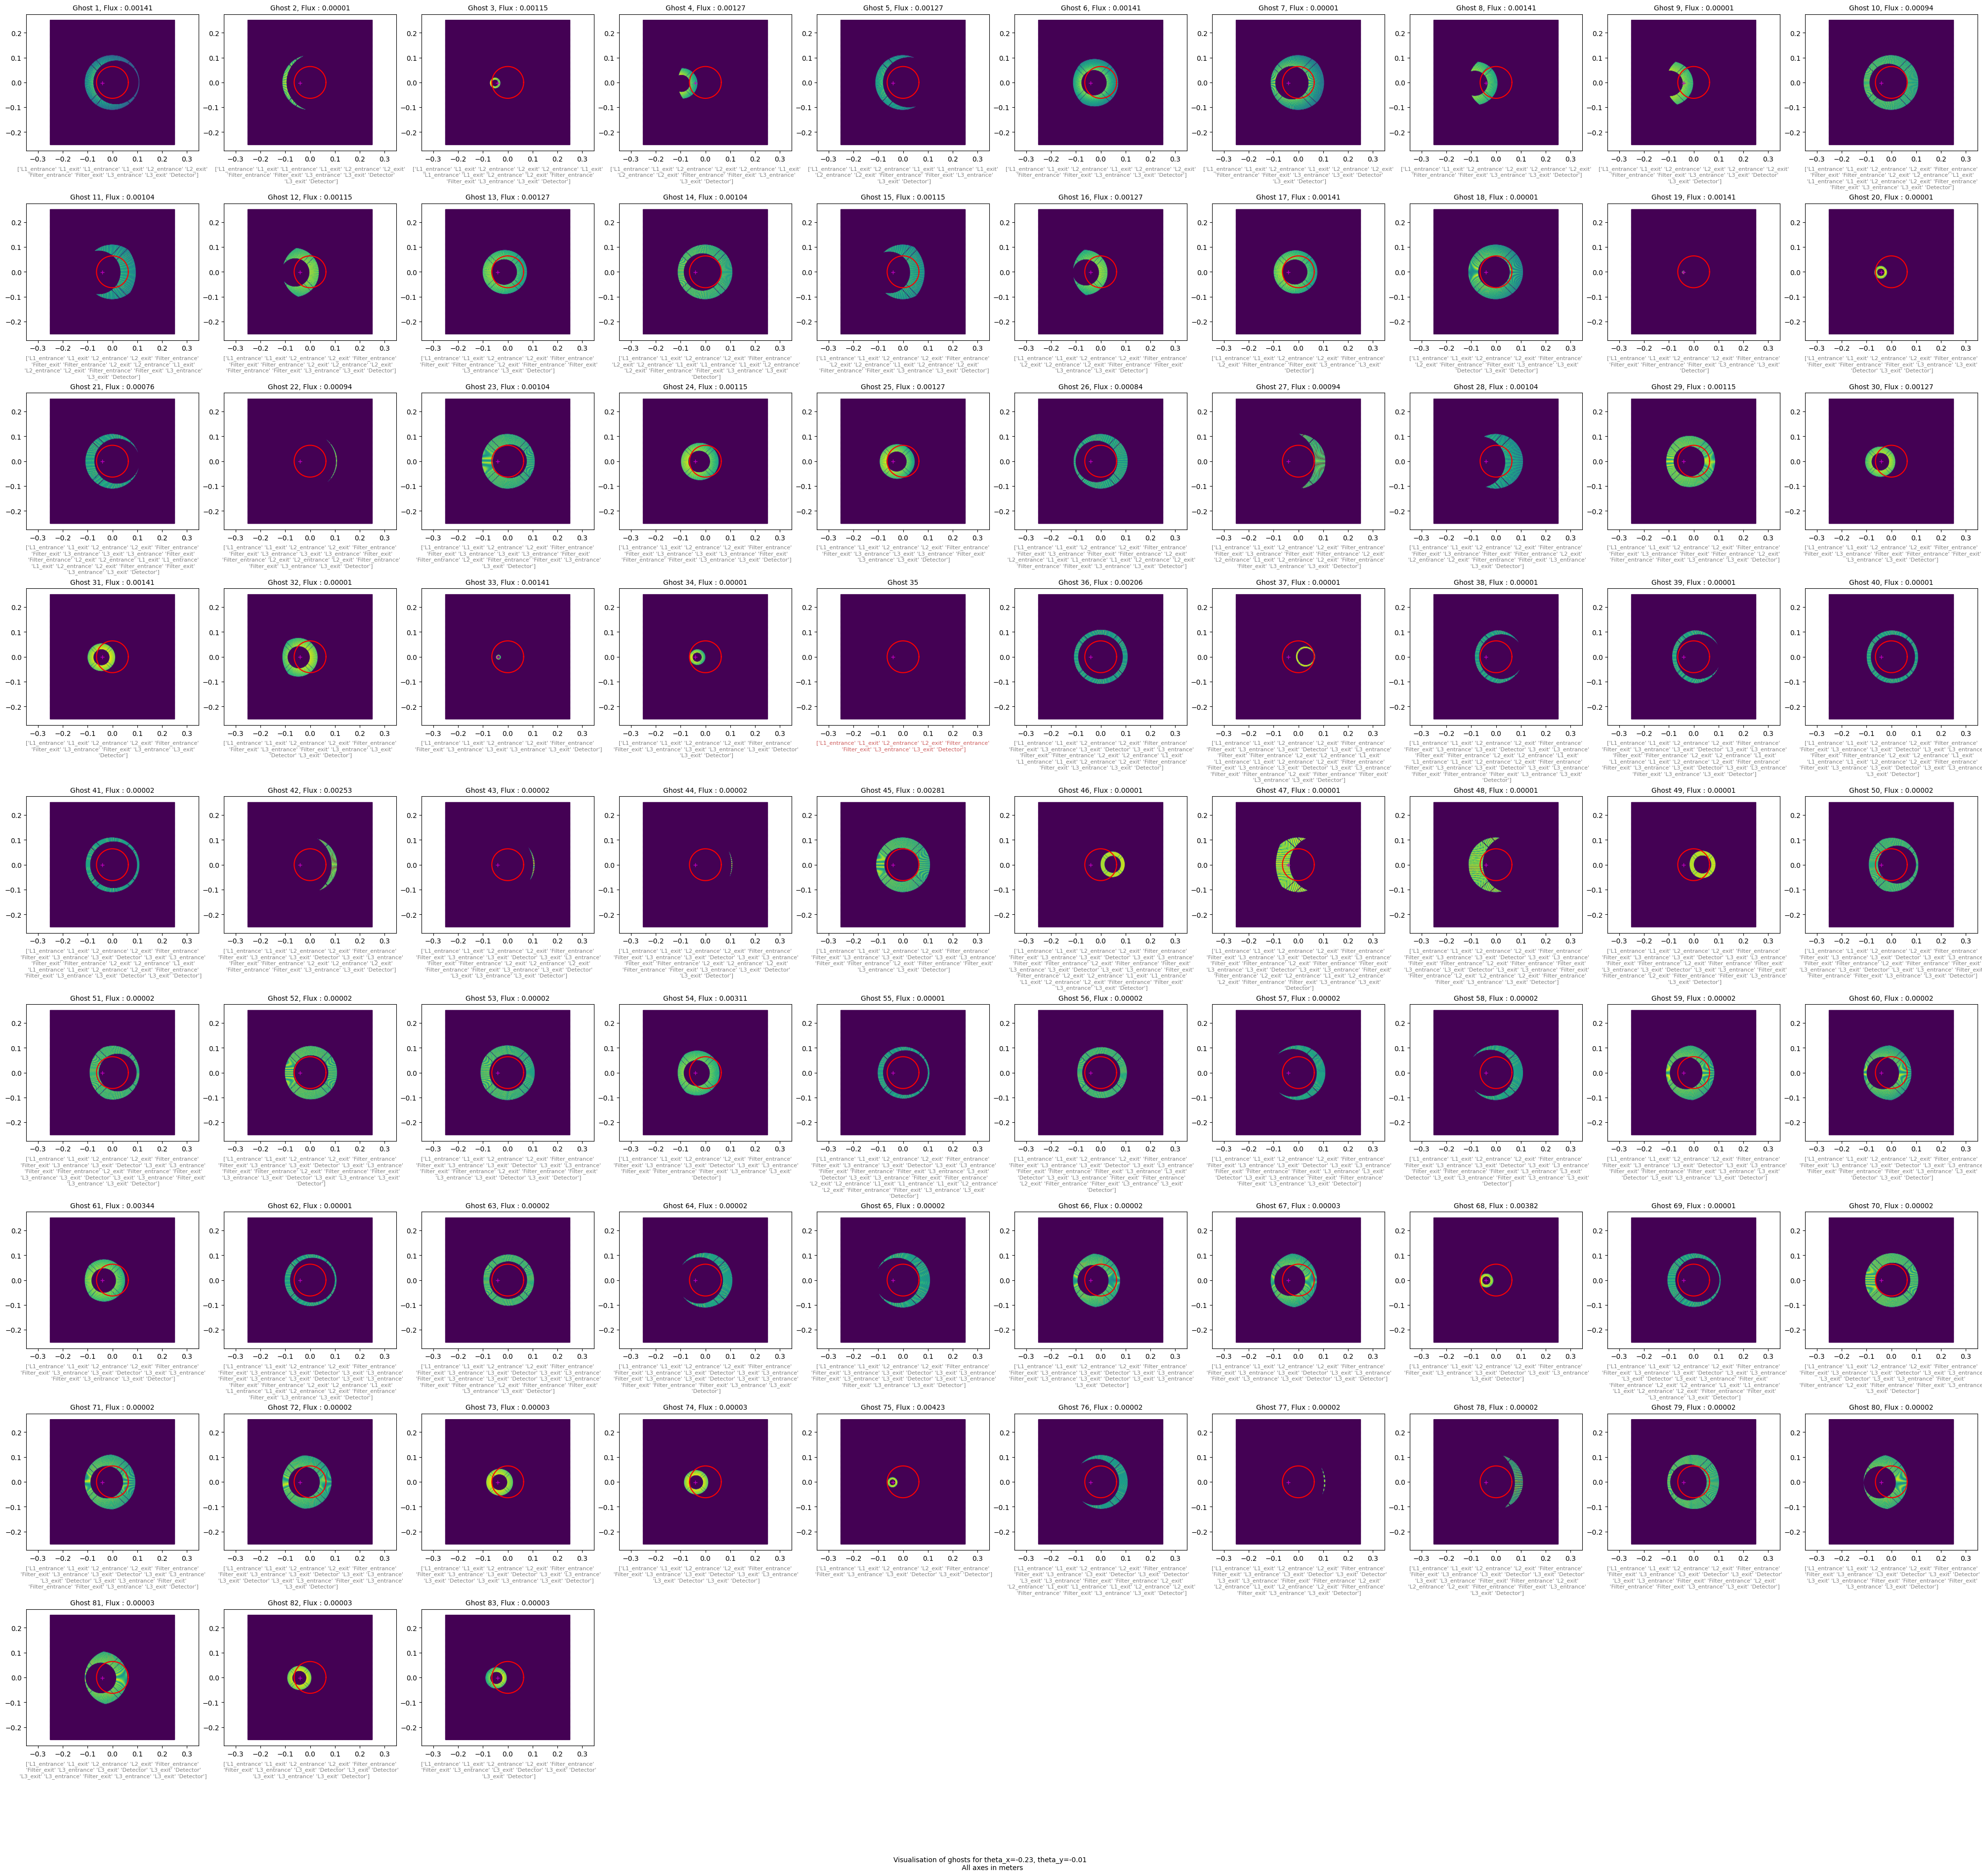
Batoid package (2)

Slide 5
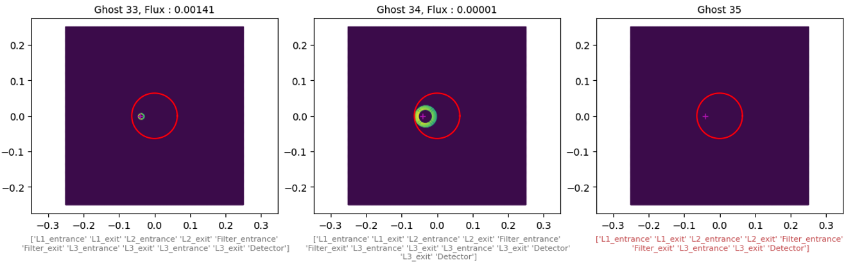
Batoid package (2)
First order
Third order
Shortest path

Slide 6
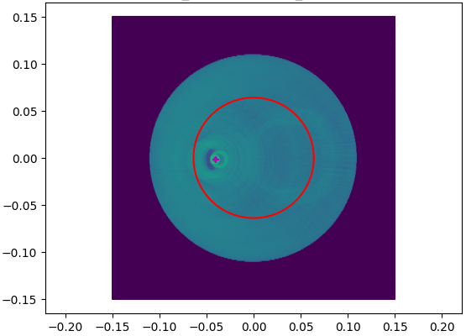
Batoid package (3)

Slide 7

Ghost buster package (1)
Goal :
Remove ghosts on ComCam’s image
(and after apply on LSSTCam’s image)
Understand sources of ghosts and physics behind
Understand artefacts and noise

Slide 8
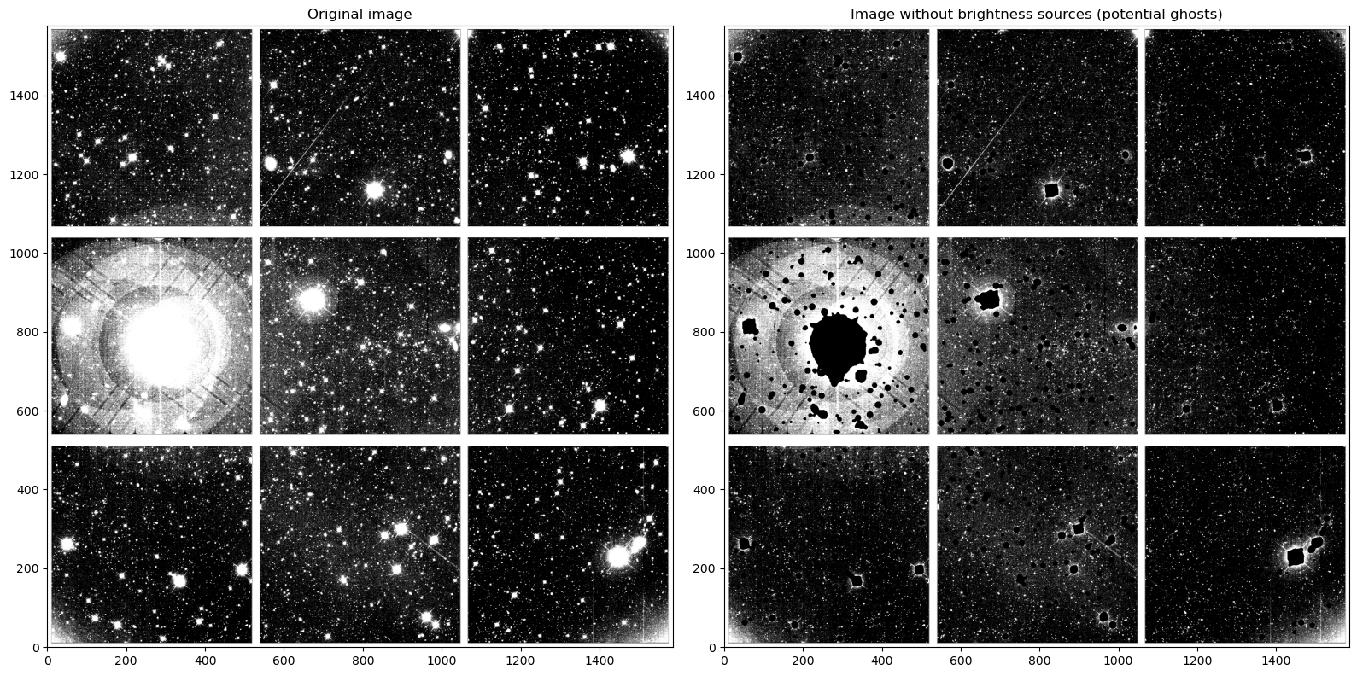
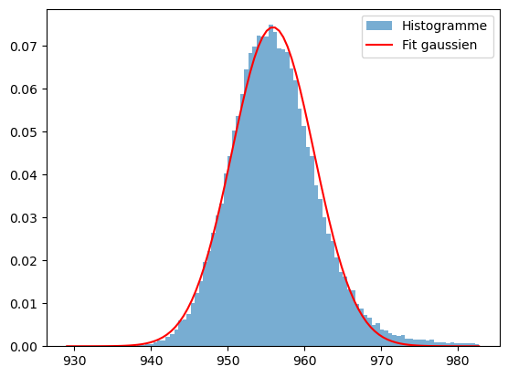
Ghost buster package (2)
1. Get the noise

Slide 9
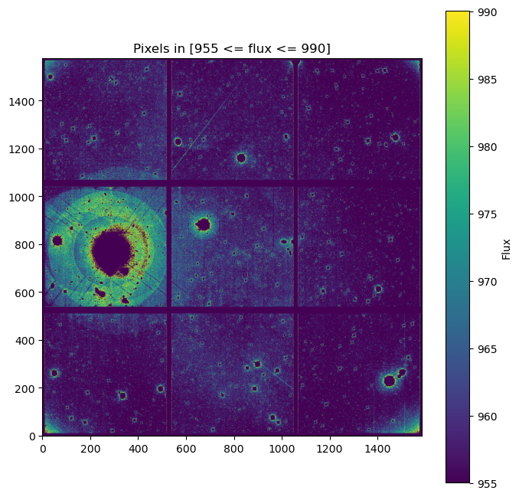
Ghost buster package (3)
2. Noise vs Ghosts

Slide 10
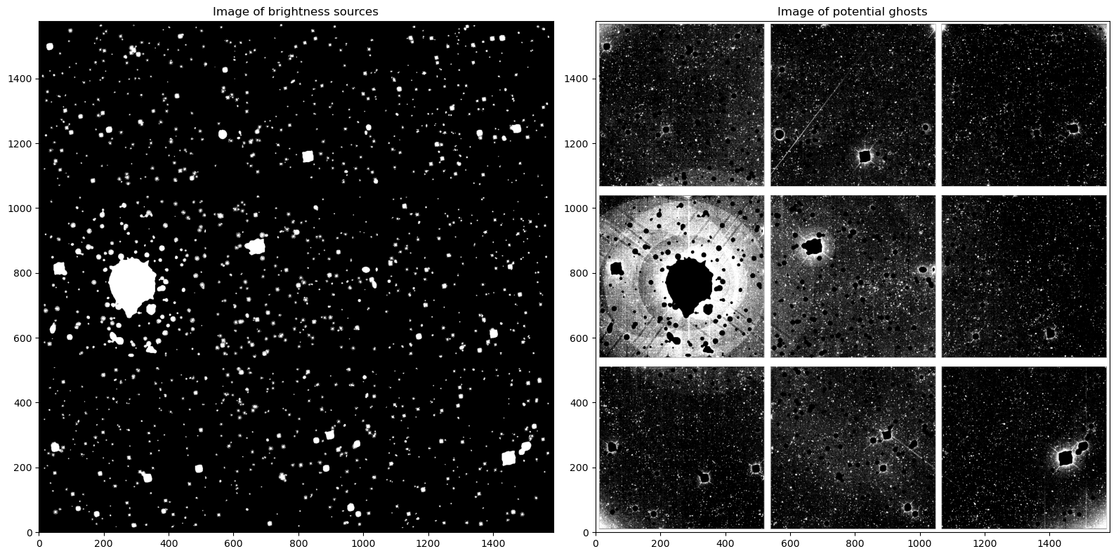
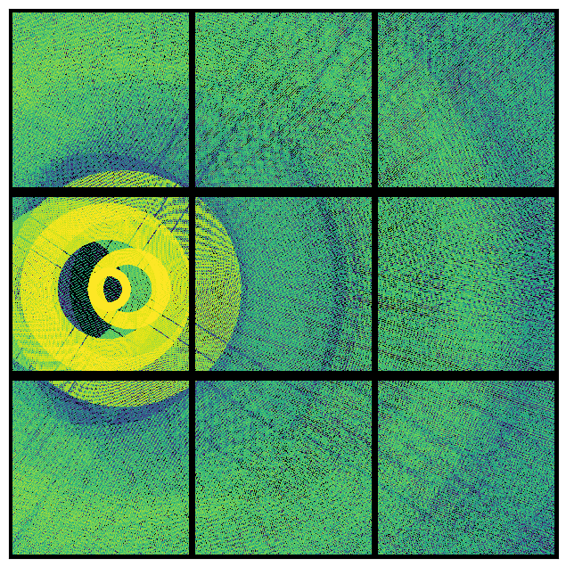
Ghost buster package (4)
3. Get simulation

Slide 11
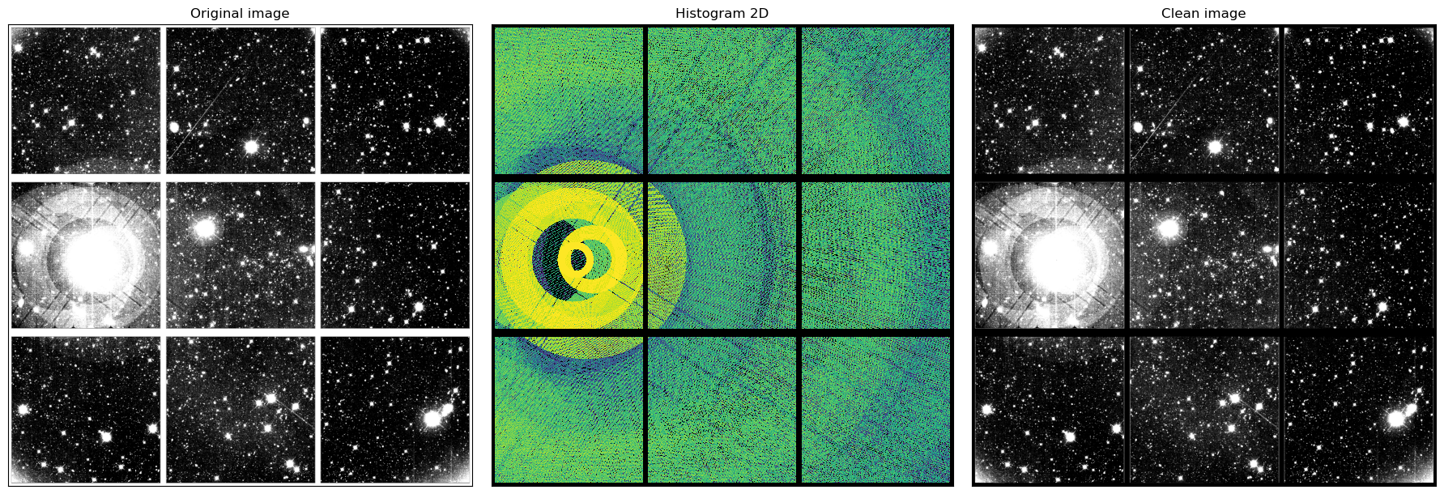
Ghost buster package (5)
4. Substract Ghosts

Slide 12
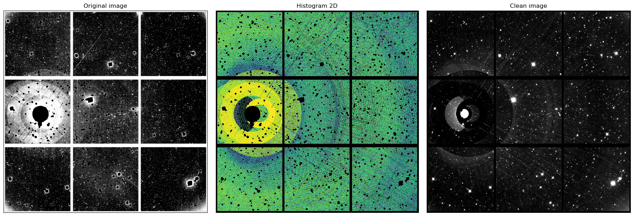
Ghost buster package (6)
5. Substract Ghosts #2

Slide 13

Ghost buster package (7)
6. Artefacts

Slide 14
Ghost buster package (8)
7. Artefacts #2 (iMinuit)

Slide 15
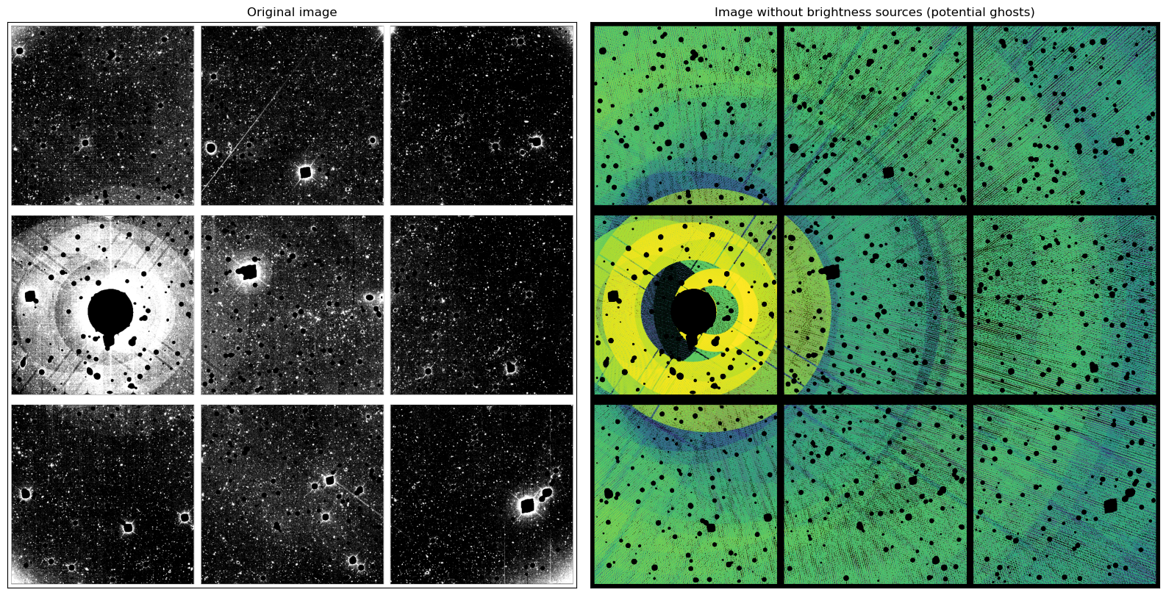
Some problems… (1)

Slide 16
Some problems… (2)
Spider’s position
Source of ghosts coordinates
Reflection/Transmition coefficients
Overfit, how to stress parameters during the fit ?

Slide 17
Actual and future work
Scipy to iMinuit → Better control of the fit and better for analysis
Smooth image and simulation
Use Gaia catalog and Wcs to obtain better coordinates of source
Use GalSim

Slide 18
Previously… (1)
Goal :
Remove ghosts on ComCam’s image
(and after apply on LSSTCam’s image)
Understand sources of ghosts and physics behind
Understand artefacts and noise

Slide 19
Previously… (2)

Slide 20
Previously… (3)
Data = A * Temp_ghosts + SkyBackground

Slide 21
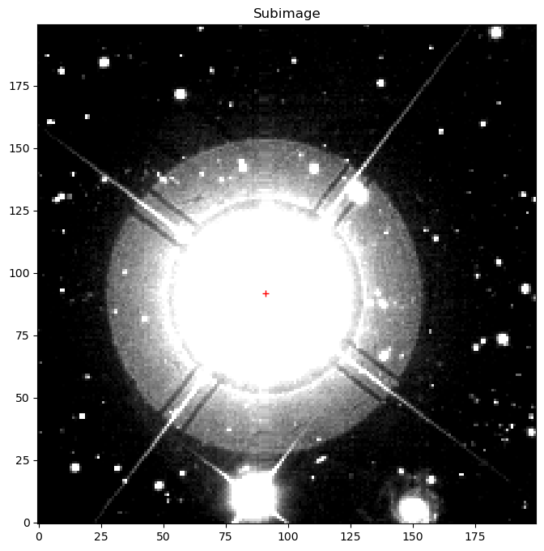
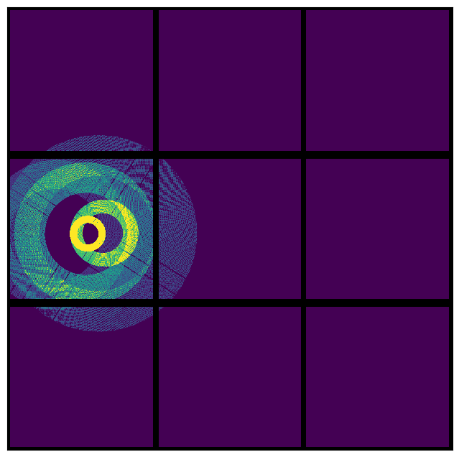
Update on ghosts
- We use a script to determine the position of the brightest star
- We only keep ghosts visible to the naked eye

Slide 22
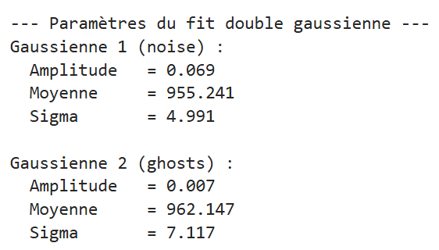
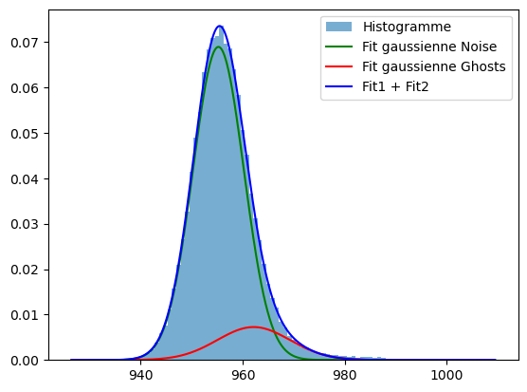
Update on noise
Intensity histogram of data without brighness sources

Slide 23
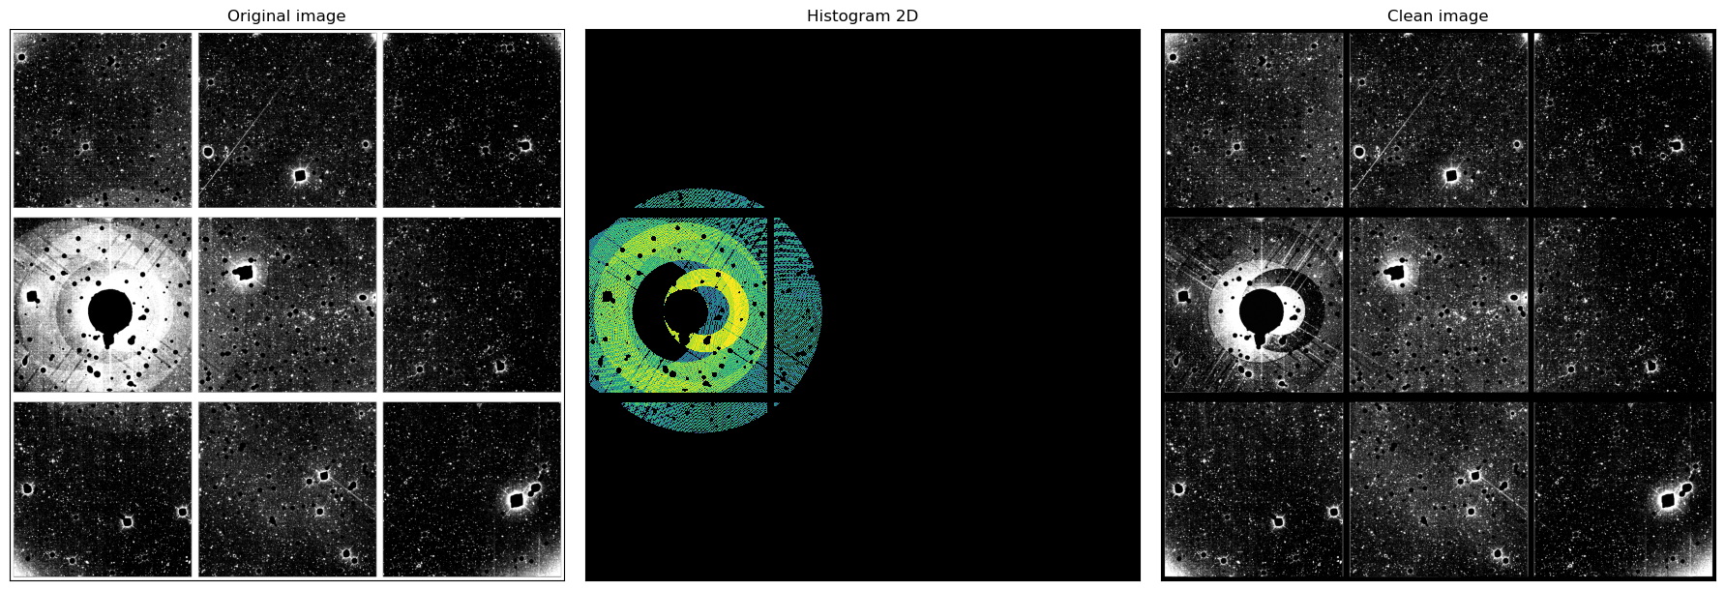
Update on fit
Extern ghosts : very good fit
Intern ghosts : little shift, overfit
Spiders : bad rotation
Here, we fit only the amplitude of ghosts
SkyBackground was fixed on mean value of noise

Slide 24
And another problem…
Ghost ?
Ghost from another bright star ?
Or another optic effect ?

Slide 25
And an idea !
Ghost ?
Ghost from another bright star ?
Or another optic effect ?
Airy’s rings

Slide 26
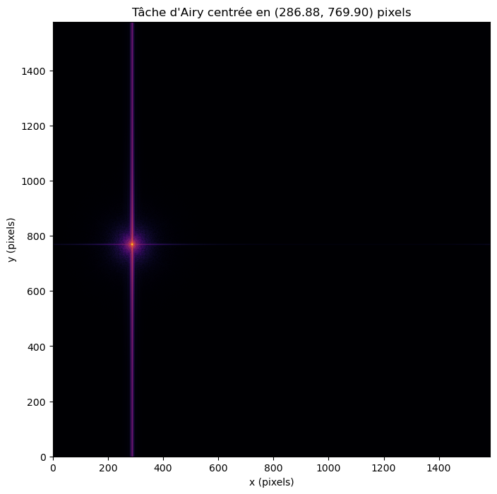
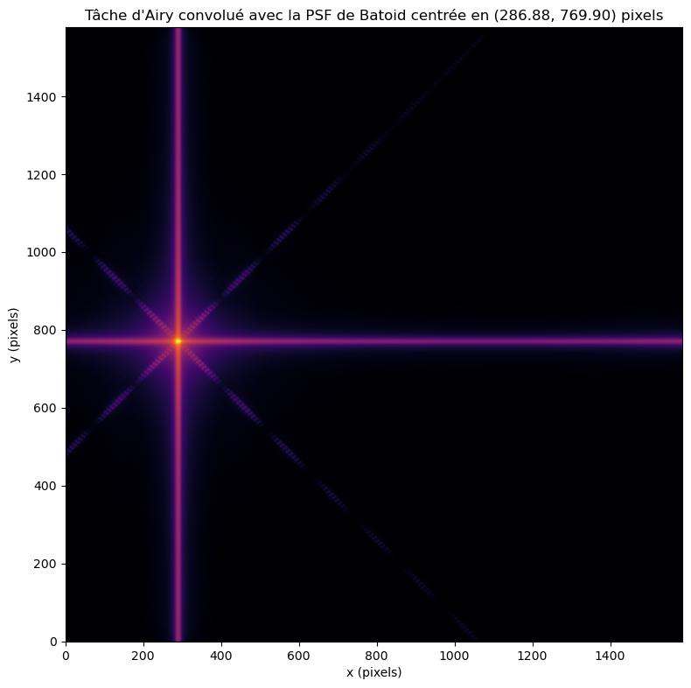
PSF and Airy’s rings
In the following we will only use the PSF of Batoid because there are bugs with Airy

Slide 27
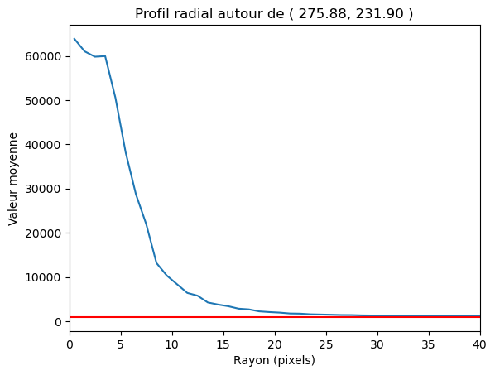
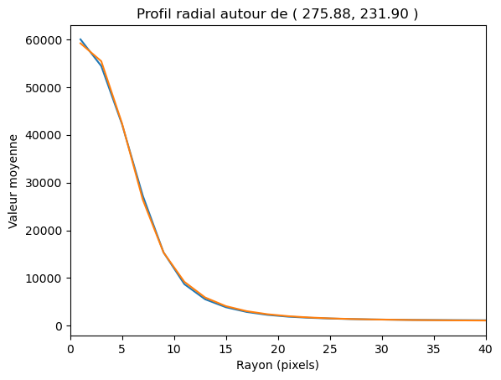
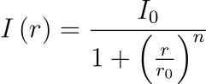
Intensity profil (data)
Raw data, redline = noise
Effect of satured star ?
Smooth data and fit

Slide 28
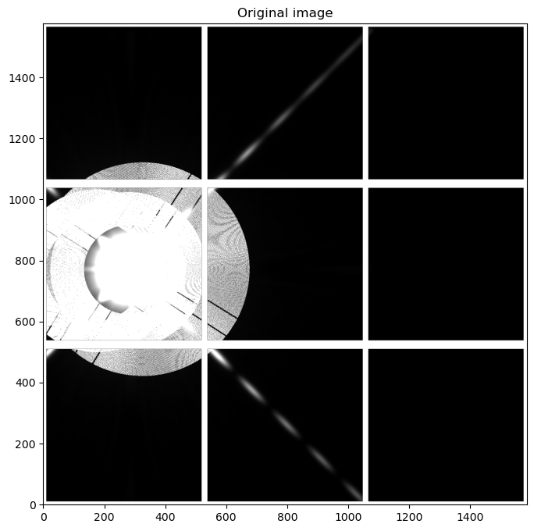
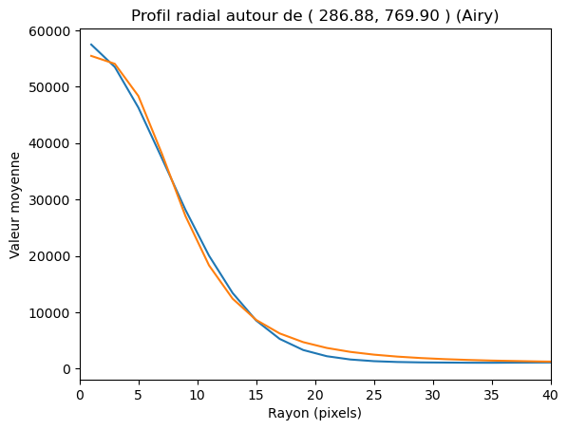
Intensity profil (template)
(Temp ghosts fit) + (Gaussian2D with satured effect) ⊗ (PSF of Batoid)

Slide 29
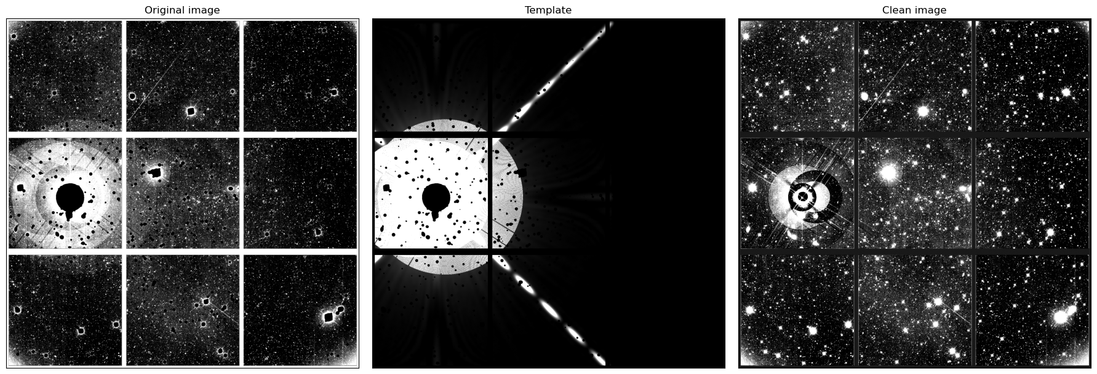
Fit with PSF

Slide 30
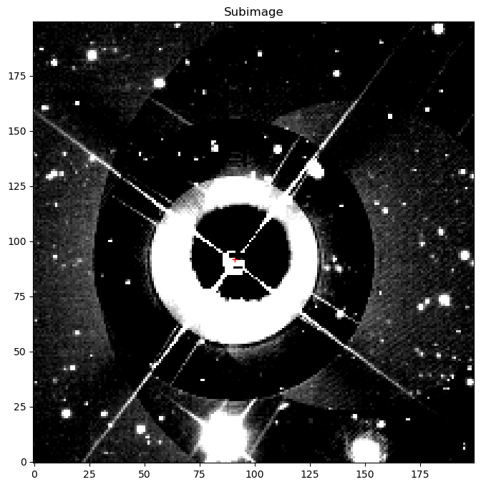
Conclusion
Branch → Cause by Airy’s rings
Overfit brightest star
Satured heart of brightest star
Underfit brightest star
Overfit brightest ghost

Slide 31
Conclusion
In very good way
Need to find a solution for spiders
And study the reflection rates of lenses
Find a better model for brightest star
And study batoid’s PSF / Airy’s rings

Slide 32
Thank you for your attention

